Slide 1

Industrial Safety and Health
Report made by Nitish T.

Slide 2
Author Information
LinkedIn: Nitish Joson Terance Joe Heston | LinkedIn
GitHub: AstroAtomic (Nitish Joson Terance Joe Heston)
Codeforces: https://codeforces.com/profile/joson1005

Slide 3
Introduction

Slide 4
Description of the Dataset
This dataset shows records of accidents from twelve different plants in three different countries from 2016 to 2017
The primary reason the author is sharing this dataset with the community is to encourage the exploration of the data and the generation of insights that manufacturing plants can use to improve workplace safety and ultimately save lives.
As such, this presentation aims to explore the dataset, uncover meaningful insights, and provide findings that manufacturing plants can use to improve workplace safety and help save lives.
Dataset Author: IHM Stefanini
Dataset Link: Industrial Safety and Health Analytics Database

Slide 5
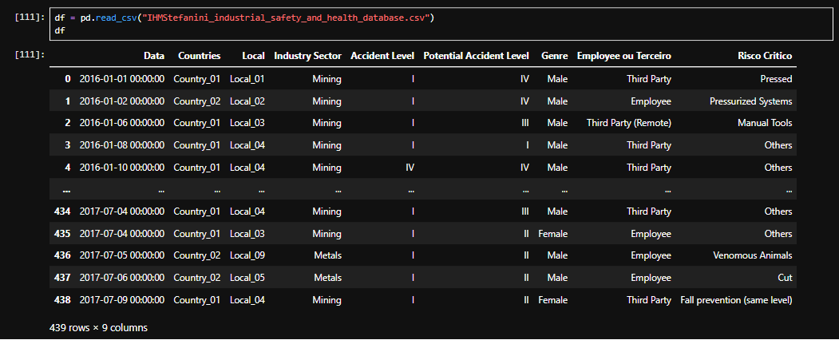
Features of the Dataset
The Features of the Dataset are the nine columns shown in the above table

Slide 6
Definitions
‘Data’ refers to the date of the incident.
‘Countries’ refers to the country where the incident originated from. There are three anonymous countries in this dataset.
‘Locals’ refers to the plant where the incident originated from. There are twelve anonymous plants in this dataset.
‘Industry Sector’ refers to the industry where the incident originated. There are three in this dataset: Mining, Metals, Others
‘Genre’ refers to the sex of the person who got in the accident (Male, Female).
‘Risco Critico’ refers to the type of accident that occurred. There are multiple different types present in this dataset.

Slide 7
Definitions – Employee ou Terceiro
Employee ou Terceiro Refers to the type of person who got injured.
Employee: A person employed at the manufacturing plant, such as a front-line worker, machine operator, or supervisor.
Third Party: A person who is not employed at the manufacturing plant, such as a visitor, inspector, contractor, or delivery driver.
Third Party (Remote): A person who is not employed at the manufacturing plant and is involved in an incident that occurs away from the plant site, such as a truck driver transporting goods or a contractor working off-site.

Slide 8
Definitions – Accident Level and Potential Accident Level
Accident Level refers to the severity of the accident that occurred. The higher the Roman numeral, the more severe the accident. The next slide presents an intuitive severity scale for the accident levels in the dataset. However, it is important to note that the dataset does not provide official criteria or metrics explaining how each accident level is determined.
Potential Accident Level refers to how severe the accident could have been under different circumstances—in other words, the worst-case scenario. For example, a worker who was only scratched by falling rocks could have suffered a fatal injury if the rocks had struck their head instead.

Slide 9
Intuitive Severity Scale
Roman Numeral | Severity | Description
I | Very Low | Minor incident with minimal injury or impact.
II | Low | Minor injury requiring limited medical attention.
III | Moderate | Injury requiring medical treatment and some recovery time.
IV | High | Serious injury with significant consequences.
V | Very High | Critical injury with life-threatening consequences.
VI | Extreme | Catastrophic or fatal incident.

Slide 10
Exploratory Data Analysis (EDA)

Slide 11
Author’s Note
All of the analysis in this report is based solely on this dataset. Other than the information provided by the dataset's author, I have no way of verifying where the data came from or how it was collected. Because of this, the dataset may contain limitations or biases, such as incomplete reporting, confidentiality restrictions, or skewed results. These potential limitations should be kept in mind when interpreting the findings throughout this analysis.
As a result, the analysis in this project is intended to identify patterns and areas for further investigation rather than make definitive claims about the industry as a whole. The findings should be viewed as observations based on the available data, not as conclusions that apply universally.

Slide 12
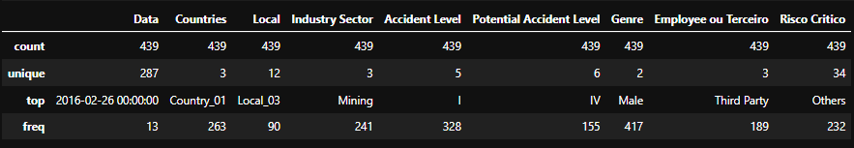
Basic Information
The table below provides a summary of the key characteristics of the dataset. Count represents the total number of records, Unique shows the number of distinct values, Top indicates the most frequently occurring value, and Freq shows how many times that value appears in the dataset. From this table, we note that there are 439 elements in this table.

Slide 13
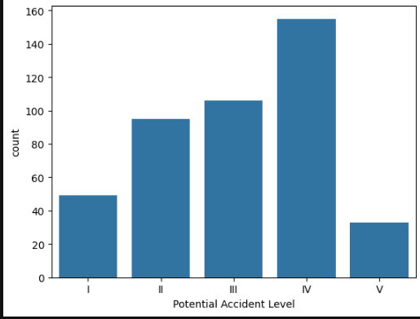
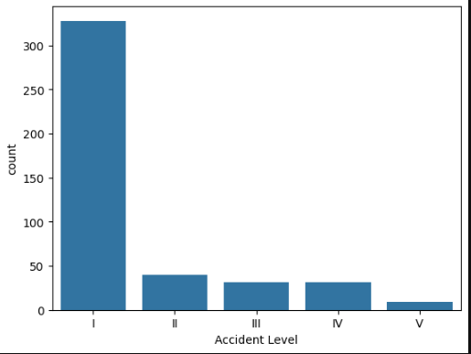
Frequency Counts of Accident Level
Most of the recorded accidents are relatively minor. However, as shown by the Potential Accident Level Chart, many of these incidents could have had much more serious consequences if circumstances had been slightly different. This shows the importance of treating even minor accidents seriously, as they can reveal hazards that have the potential to result in far more severe injuries. Note that VI was hidden in Potential Accident Level as only one accident was classified as such.

Slide 14
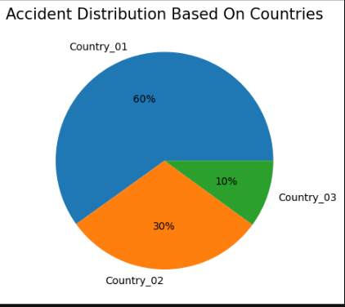
Accident Distribution Based On Country
Analysis: Country_01 has the greatest number of accidents out of all the other countries. However, this could be because more industry exists in that country, so we cannot say that the country is less safe. As the twelve Plants also follow a similar trend, I have chosen not to show their relative distribution (Also, it doesn’t reveal any new insights either).
Furthermore, I have chosen not to show the Accident Level distribution for the pie chart representation (this one and the following ones) as they show the same insight as the previous slide and don’t reveal any new information.

Slide 15
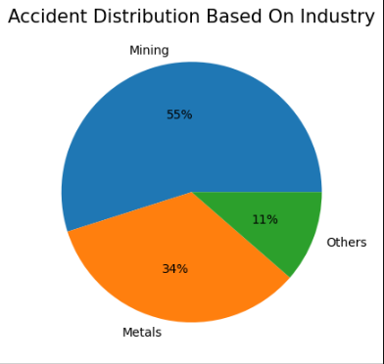
Accident Distribution Based On Industry
Analysis: Mining has the highest number of recorded accidents in the dataset, followed by the Metals industry, with the remaining industries reporting considerably fewer incidents. This suggests that Mining and Metals may involve higher-risk working environments, likely due to the nature of the work, heavy machinery, and challenging operating conditions. However, without information such as the number of workers or hours worked in each industry, it is not possible to conclude that these industries are inherently less safe — only that they recorded more accidents in this dataset.

Slide 16
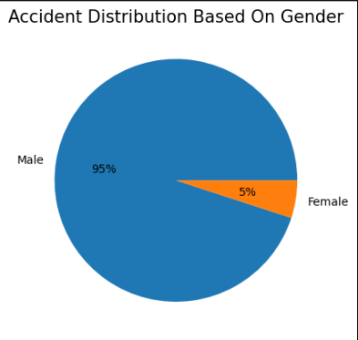
Accidents Based On Sex
Analysis: The data shows that significantly more injuries involve males than females. While this might suggest that men experience more workplace accidents, it is important to consider the workforce makeup. Industries such as mining and metals are traditionally male-dominated, so the higher number of male injuries is likely influenced by the larger number of men working in these environments. Without knowing the proportion of male and female workers, it is not possible to conclude that one sex is more at risk than the other.

Slide 17
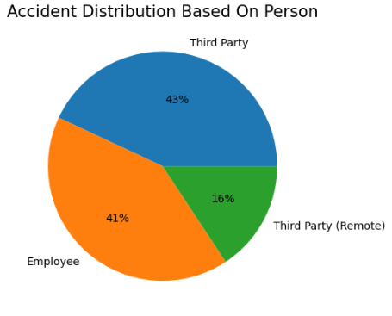
Accident Distribution Based on Person
Analysis: The dataset shows that a surprisingly high number of recorded injuries involve Third Party Persons. Most people would expect employees to make up the majority of workplace accidents, so this stands out. A possible reason is that third-party workers, such as contractors or visitors, may not be as familiar with the site's safety procedures or work environment as regular employees. This finding suggests that more attention may be needed to ensure everyone on site, not just employees, is properly informed about workplace safety.

Slide 18
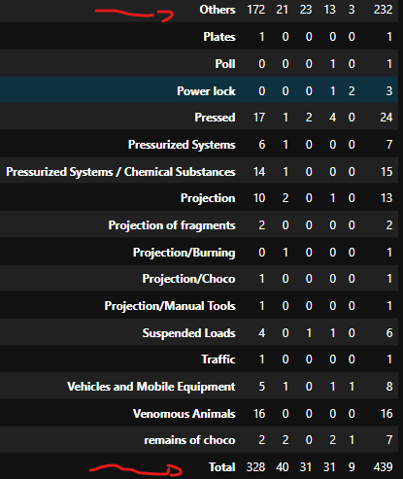
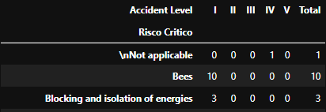
Causes of Injuries
**NOT ALL CAUSES LISTED IN IMAGE**
There are 34 unique causes listed in the dataset. However, more than half of all accidents are grouped under "Others," making it difficult to determine the most common causes of workplace accidents. Even so, the data reveals some interesting insights. A small number of injuries were caused by factors such as venomous animals. While these hazards are not directly related to mining equipment or operations, they are still part of the work environment. This shows the importance of taking appropriate precautions against environmental hazards, even if they are outside the company's direct control.

Slide 19
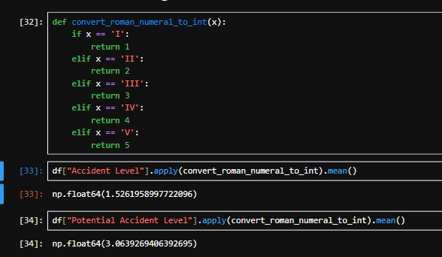
Accident Level and Potential Accident LevEl
Analysis: By using a custom function, we find that the mean of the Accident Levels in this dataset is ~1.5 and the mean of the Potential Accident Levels is ~3.0 in this dataset. This means that, on average, the actual accident that occurred is around ½ the severity of it’s worst-case scenario

Slide 20
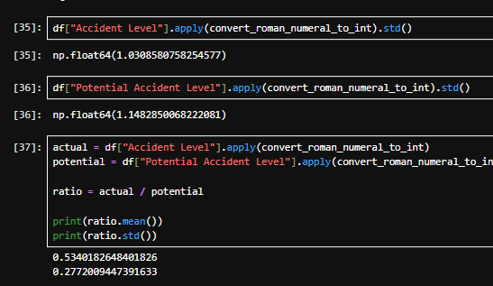
Standard Deviation of the Ratio
The Ratio mentioned from last slide is 53.4% and the standard deviation of the ratio, 27.8%, suggests moderate variability, meaning that while actual accidents were generally about half as severe as their potential outcomes, the proportion differed noticeably across individual incidents.

Slide 21
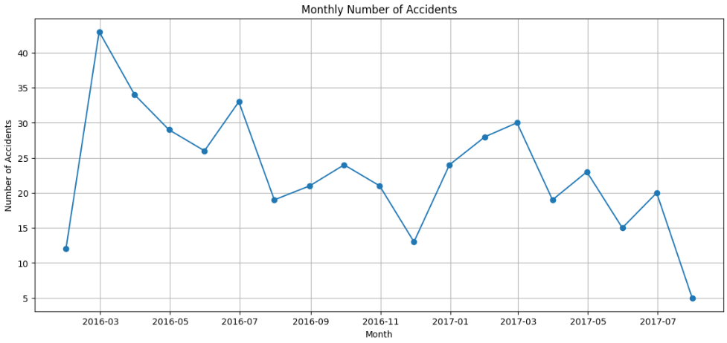
Trend of Accidents Based on Time
Analysis: Both the 2016 March and 2017 March stand out as the months with the highest number of accidents before the numbers begin to drop again. This may simply be a coincidence, but it could also suggest that certain factors during this time of year contribute to a higher number of accidents. It would be worth exploring whether seasonal conditions, workload, or other real-world factors play a role. Overall, despite the spike in March, the general trend shows that the number of accidents decreased over time.

Slide 22
The End

